Slide 1
L8 Cache Part I
Zonghua Gu, 2018
5/3/2018
Acknowledgement: some slides taken from UC Berkeley CS61C

Slide 2
Outline
Memory Hierarchy and Latency
Cache Principles
Basic Cache Organization
Different Kinds of Caches
Write Back vs. Write Through
Summary
5/3/2018
Fall 2017 – Lecture #14

Slide 3
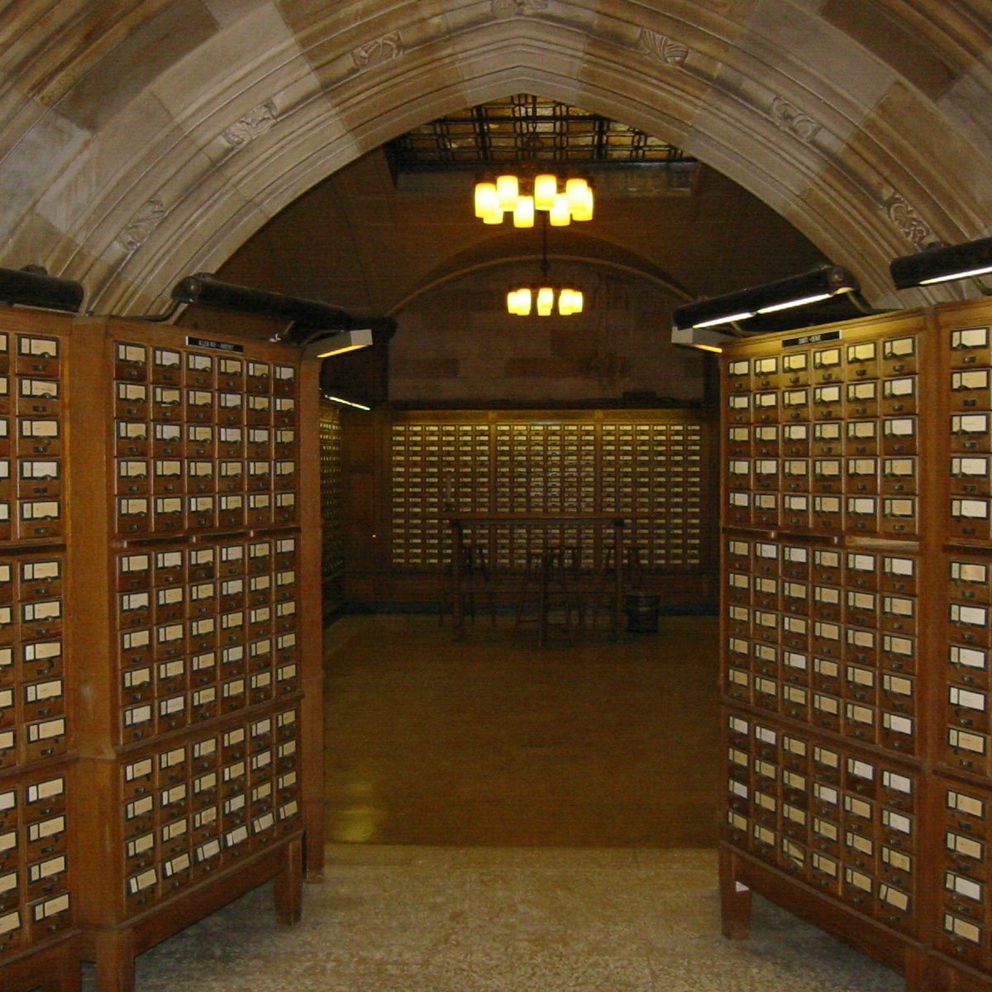

Why are Large Memories Slow? Library Analogy
Time to find a book in a large library
Search a large card catalog – (mapping title/author to index number)
Round-trip time to walk to the stacks and retrieve the desired book
Larger libraries worsen both delays
Electronic memories have same issue, plus the technologies used to store a bit slow down as density increases (e.g., SRAM vs. DRAM vs. Disk)
However what we want is a large yet fast memory!
5/3/2018

Slide 4
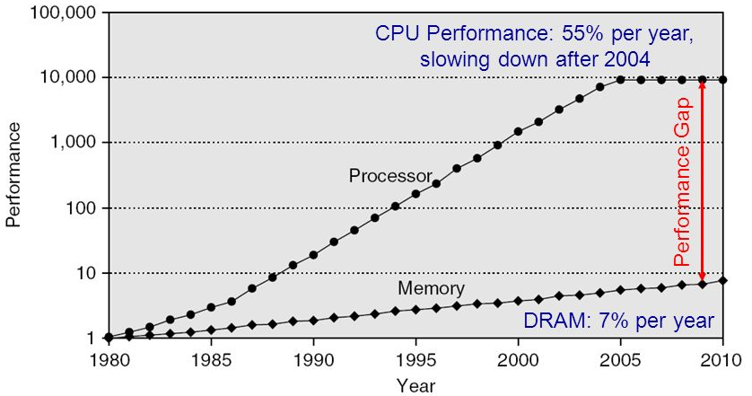
Processor-DRAM Gap (Latency)
1980 microprocessor executes ~one instruction in same time as DRAM access
2017 microprocessor executes ~1000 instructions in same time as DRAM access
Memory wall: memory access likely to be the performance bottleneck
5/3/2018
Notes:
Why doesn’t DRAM get faster?

Slide 5
What To Do: Library Analogy
Write a report using library books
Go to library, look up relevant books, fetch from stacks, and place on desk in library
If need more, check them out and keep on desk
But don’t return earlier books since might need them
You hope this collection of ~10 books on desk enough to write report, despite 10 being only 0.00001% of all books in the library
5/3/2018

Slide 6
Outline
Memory Hierarchy and Latency
Cache Principles
Basic Cache Organization
Different Kinds of Caches
Write Back vs. Write Through
Summary
5/3/2018
Fall 2017 – Lecture #14

Slide 7
Memory Hierarchy
Big, Slow Memory
(DRAM)
Cache
Small, Fast
(SRAM)
CPU
Registers
holds frequently used data
Capacity: register << cache (typically on-chip) << memory (off-chip)
Latency: register << cache (typically on-chip) << memory (off-chip)
On a data access:
if data ∈ cache ⇒ cache hit ⇒ low latency access (SRAM)
if data ∉ cache ⇒ cache miss ⇒ high latency access (DRAM)
Goal: create the illusion of accessing as much memory as is available in the slow memory at the speed of the fast cache
Notes:
Due to cost
Due to size of DRAM
Due to cost and wire delays (wires on-chip cost much less, and are faster)
When accessing a memory address, one of two things can happen:
Cache hit: cache block is valid and refers to the proper memory address, so read from cache (fast)
Cache miss: cache block is invalid, or refers to the wrong memory address, so read from memory (slow)

Slide 8
Memory Hierarchy Technologies
Caches use SRAM (Static Random Access Memory) for speed and technology compatibility
Fast (typical access times of 0.5 to 2.5 ns)
Low density (6 transistor cells), higher power, expensive
Static: content will last as long as power is on
Main memory uses DRAM (Dynamic RAM) for size and density
Slower (typical access times of 50 to 70 ns)
High density (1 transistor cells), lower power, cheaper
Dynamic: needs to be “refreshed” regularly (every ~8 ms)
Consumes 1% to 2% of the active cycles of the DRAM
Notes:
Size comparison: DRAM/SRAM is 4 to 8 times
Cost/cycle time comparison SRAM/DRAM is 8 to 16 times
http://parts.digikey.com/1/parts/1211303-ic-sram-1mbit-10ns-32soj-cy7c109d-10vxi.html
Quantity discount 10ns 1MBit SRAM $2.24, $17/Mbyte, $1700/100 Mbyte, $17000/GByte
http://www.frys.com/template/harddrives
DRAM: 4GB @ $70 or $17.50 per GB
24GB@$800 = $33/Gbyte
http://www.frys.com/category/Outpost/Hard+Drives+&+Memory/Memory/Notebook+Memory/Apple+-+Mac++Memory/
DDR2 1GB @ $25 per
DDR3 1 GB @ $37.5 per
FLASH Media
Approx. $2 per Gbyte

Slide 9
Cache Blocks
CPU
Smaller, faster, more expensive memory
Typical block size: 1 – 4 words (4 – 16 Bytes)
Cache
7
9
14
3
14
Memory
0
1
2
3
Larger, slower, cheaper memory.
4
5
6
7
8
9
10
11
12
13
14
15

Slide 10
General Cache Concepts: Hit
CPU
Data in block b is needed
Request: 14
Block b is in cache:
Hit!
Cache
7
9
14
3
14
Data is loaded from cache into CPU register
Memory
0
1
2
3
4
5
6
7
8
9
10
11
12
13
14
15

Slide 11
General Cache Concepts: Miss
CPU
Data in block b is needed
Request: 12
Block b is not in cache:
Miss!
Cache
7
9
14
3
12
Block b is fetched from
memory
12
Request: 12
Block b is stored in cache
Placement policy: determines where b goes
Replacement policy: determines which block gets evicted (victim)
Memory
0
1
2
3
4
5
6
7
8
9
10
11
12
12
13
14
15
Data is loaded from cache into CPU register

Slide 12
Chip Photos
5/3/2018

Slide 13
Memory Hierarchy Speed vs. Size
On-Chip Components
CPU Control
Instr
Cache
Second
Level
Cache
(SRAM)
Secondary
Memory
(Disk
Or Flash)
Main
Memory
(DRAM)
CPU
Datapath
RegFile
Data
Cache
Speed (cycles): ½’s 1’s 10’s 100’s 1,000,000’s
Size (bytes): 100B’s 10KB’s MB’s GB’s TB’s
Cost/bit: highest lowest
Notes:
Instead, the memory system of a modern computer consists of a series of black boxes ranging from the fastest to the slowest.
Besides variation in speed, these boxes also varies in size (smallest to biggest) and cost.
What makes this kind of arrangement work is one of the most important principle in computer design. The principle of locality. The principle of locality states that programs access a relatively small portion of the address space at any instant of time.
The design goal is to present the user with as much memory as is available in the cheapest technology (points to the disk).
While by taking advantage of the principle of locality, we like to provide the user an average access speed that is very close to the speed that is offered by the fastest technology.
(We will go over this slide in detail in the next lectures on caches).
Programmer-invisible hardware mechanism gives illusion of speed of fastest memory with size of largest memory
Works even if you have no idea what a cache is
Performance-oriented programmers sometimes “reverse engineer” cache organization to design data structures and access patterns optimized for a specific cache design

Slide 14
How is the Hierarchy Managed?
Registers ↔ memory hierarchy
By compiler (or assembler programmer)
Cache ↔ main memory
By the cache controller hardware
Focus of this lecture
Main memory ↔ disks (secondary storage)
By the operating system (virtual memory)
By the programmer (files)
Notes:
Virtual to physical address mapping assisted by the hardware (Translation LB)

Slide 15
Principle of Locality
Principle of Locality: Programs access small portion of address space at any instant of time (spatial locality) and repeatedly access that portion (temporal locality)
Temporal Locality (locality in time)
Go back to same book on desk multiple times
If a memory location is referenced, then it will tend to be referenced again soon
Keep recently-accessed blocks in the cache
Spatial Locality (locality in space)
When go to book shelf, pick up multiple books around the book you want, since library stores related books together
If a memory location is referenced, the locations with nearby addresses will tend to be referenced soon
When fetching a block into cache, also fetch blocks around it
5/3/2018
Notes:
How does the memory hierarchy work? Well it is rather simple, at least in principle.
In order to take advantage of the temporal locality, that is the locality in time, the memory hierarchy will keep those more recently accessed data items closer to the processor because chances are (points to the principle), the processor will access them again soon.
In order to take advantage of the spatial locality, not ONLY do we move the item that has just been accessed to the upper level, but we ALSO move the data items that are adjacent to it.
+1 = 15 min. (X:55)

Slide 16
Quiz: What locality does this program have?
int sum = 0, a[n];
…
for (i = 0; i < n; i++) {
sum += a[i];
}
return sum;
Data:
Temporal locality: variable sum is referenced in each iteration
Spatial locality: array a[] is accessed with stride-1 in each iteration (assuming a[] is stored in contiguous addresses in memory)
Instructions:
Temporal locality: the loop body is executed repeatedly for n times
Spatial locality: instructions are accessed sequentially (with 1 branch in each iteration) (assuming instructions are stored in contiguous addresses in memory)

Slide 17
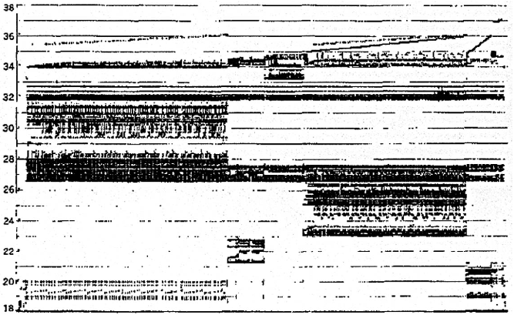
Memory Reference Patterns
Temporal
Locality
Memory Address (one dot per access)
Spatial
Locality
Donald J. Hatfield, Jeanette Gerald: Program Restructuring for Virtual Memory. IBM Systems Journal 10(3): 168-192 (1971)
Time
5/3/2018

Slide 18
Memory Reference Patterns
Address
n loop iterations
Instruction
fetches
subroutine call
subroutine return
Stack
accesses
argument access
vector access
Data
accesses
scalar accesses
Time
5/3/2018

Slide 19
Outline
Memory Hierarchy and Latency
Cache Principles
Basic Cache Organization
Different Kinds of Caches
Write Back vs. Write Through
Summary
5/3/2018
Fall 2017 – Lecture #14

Slide 20
Processor with Cache
Processor
Memory
Enable?
Read/Write
Input
Control
Program
Cache
Datapath
Memory (including
cache) organized around blocks, which are typically multiple words
Address
Bytes
PC
Write Data
Registers
Data
Arithmetic & Logic Unit
(ALU)
ReadData
Output
Processor organized around words and bytes
Processor-Memory Interface
I/O-Memory Interfaces
5/3/2018

Slide 21
Cache vs. Memory
Cache size << memory size
Smaller cache is faster
1-to-many correspondence between cache blocks and memory blocks
Use Tags in the cache to match cache and memory blocks
A cache block is also called a cache line

Slide 22
Block Must be Aligned in Memory
If each cache block is 4 Bytes (1 word), then binary address each cache block always ends in 00_{two}
How to take advantage of this to save hardware and energy?
Don’t need to compare last 2 bits of 32-bit byte address (comparator can be narrower)
Don’t need to store last 2 bits of 32-bit byte address in Cache Tag (Tag can be narrower)
If each cache block is 8 Bytes (2 words), then binary address each cache block always ends in 000_{two}
5/3/2018

Slide 23
Tradeoffs of Cache Block Sizes
Smaller cache blocks → more fine-grained caching → take better advantage of temporal locality
A given data item stays in the cache longer before getting replaced
Larger cache blocks → more coarse-grained caching, take better advantage of spatial locality
Fetching each cache block brings in lots of data at nearby addresses into the cache
In either case, if the program has poor temporal or spatial locality, then lots of junk may be brought into cache

Slide 24
Outline
Memory Hierarchy and Latency
Cache Principles
Basic Cache Organization
Different Kinds of Caches
Write Back vs. Write Through
Summary
5/3/2018
Fall 2017 – Lecture #14

Slide 25
Alternative Cache Organizations
A memory block is mapped to one cache set, which may contain one or more cache blocks
Direct Mapped (DM)
Each cache set has 1 cache block; # cache sets = # cache blocks
A memory block is mapped to 1 possible cache block
Fully Associative (FA)
A single cache set contains all cache blocks; # cache sets = 1
A memory block can be mapped to any cache block
N-way Set Associative (SA)
Each cache set has N cache blocks; # cache sets = # cache blocks / N
N is also called associativity
A memory block can be mapped to one of N possible cache blocks
DM and FA are special cases of SA
DM = 1-way SA (N = 1)
FA = N-way SA (N = total number of cache blocks)
5/3/2018

Slide 26
Alternative Cache Organizations (4-block cache）
Block Number
1 1 1 1 1 1 1 1 1 1 0 1 2 3 4 5 6 7 8 9
2 2 2 2 2 2 2 2 2 2 0 1 2 3 4 5 6 7 8 9
3 3
0 1
0 1 2 3 4 5 6 7 8 9
Memory
(32 blocks)
Where are possible locations in cache that block #12 in memory can be placed?
Set Number
Cache
(4 blocks)
0 1 2 3
0 1 0 1
0
DM 2-way SA FA (4-way SA)
In set 0 In set 0 In set 0
(1 block) (2 blocks) (4 blocks)
Notes:
Simplest scheme is to extract bits from ‘block number’ to determine ‘set’ (jse)
More sophisticated schemes will hash the block number ---- why could that be good/bad?
(12 mod 4=0) (12 mod 2=0)

Slide 27
Inside a Cache
A “valid bit” indicates of a cache block contains valid data
e.g., upon startup, the cache is “cold”: all cache blocks are invalid
The cache is “warmed-up” gradually by bringing content into the cache
A tag helps identify the memory block contained in the cache block;
Disambiguate among multiple possible memory blocks that may be mapped to the same cache block
Cache capacity refers to the total size of cache blocks (not including Tag and Valid bits)
Address
Address
Processor
CACHE
Main
Memory
Data
Data
Valid
Tag
0
100
Data
Byte
Data
Byte
Data
Byte
Data
Byte
A Cache Block
1
304
0
6848
1
416
1
1
Notes:
Tag only needs enough bits to uniquely identify the block (jse)

Slide 28
Alternative Cache Organizations（8-block cache）
Block Number
1 1 1 1 1 1 1 1 1 1 0 1 2 3 4 5 6 7 8 9
2 2 2 2 2 2 2 2 2 2 0 1 2 3 4 5 6 7 8 9
3 3
0 1
0 1 2 3 4 5 6 7 8 9
Memory
Where are possible locations in cache that block #12 in memory can be placed?
Set Number
Cache
0 1 2 3
4
5
6
7
0 1 2 3
0
1
2
3
0 1 0 1
0
1
0
1
0 1 0 1
0
1
0
1
DM 2-way SA 4-way SA FA(8-way SA)
In set 4 In set 0 In set 0 In set 0
(1 block) (2 blocks) (4 blocks) (8 blocks)
Notes:
Simplest scheme is to extract bits from ‘block number’ to determine ‘set’ (jse)
More sophisticated schemes will hash the block number ---- why could that be good/bad?
(12 mod 8=4) (12 mod 4=0) (12 mod 2=0)

Slide 29
Processor Address Fields Used by Cache Controller
Offset: Byte address within a cache block
Set Index: Selects which set
Tag: Remaining portion of processor address
Size of Set Index (SI) = log₂(number of sets)
Size of Offset = log₂(number of bytes/block)
Size of Tag = Address size – Size of SI - Size of Offset
Memory Address
Tag
Set Index
Offset
5/3/2018
Notes:
For class handout

Slide 30
Direct-Mapped Cache
Q: Given a memory block, which cache block is it mapped to?
A: Use 2 middle index bits in memory address to determine which cache block it is mapped to
00: mapped to blue block in cache
01: mapped to green block in cache
10: mapped to pink block in cache
11: mapped to grey block in cache
Main Memory
0000xx
0001xx
0010xx
0011xx
0100xx
0101xx
0110xx
0111xx
1000xx
1001xx
1010xx
1011xx
1100xx
1101xx
1110xx
1111xx
Cache
Way
Set
Valid
Tag
Data
0
1
0
2
3
Q: Is the exact memory block in the cache?
A: Compare 2 higher tag bits in memory address to the cache tag to tell if the memory block is in the cache (provided valid bit is set)
Q: Which exact Byte address in a given cache block of 4 Bytes?
A: Use the Offset
6-bit memory address: 2-bit Tag, 2-bit Set Index, 2-bit Offset (4 Bytes/block).
5
4
3
2
1
0
Tag
Set Index
Offset
Notes:
For lecture
Valid bit indicates whether an entry contains valid information – if the bit is not set, there cannot be a match for this block One word blocks
Two low order bits (xx) define the byte in the block (1 word = 4 Byes) (i.e., modulo the number of blocks in the cache)

Slide 31
DM Cache Example
Q: Given memory address 001110, is it in the cache?
Main Memory
0000xx
0001xx
0010xx
0011xx
0100xx
0101xx
0110xx
0111xx
1000xx
1001xx
1010xx
1011xx
1100xx
1101xx
1110xx
1111xx
Cache
Way
Set
Valid
Tag
Data
0
0
01
1
1
11
Q: Given memory address 0100xx, is it in the cache?
0
2
1
10
3
1
00
6-bit memory address: 2-bit Tag, 2-bit Set Index, 2-bit Offset (4 Bytes/block).
Q: Given memory address 1110xx, is it in the cache?
5
4
3
2
1
0
Tag
Set Index
Offset
Notes:
For lecture
Valid bit indicates whether an entry contains valid information – if the bit is not set, there cannot be a match for this block One word blocks
Two low order bits (xx) define the byte in the block (1 word = 4 Byes)

Slide 32
Q: Given memory address 001110, is it in the cache?
A: Yes. First, 2 middle index bits (11) means that it is mapped to grey block in cache; Second, the 2 higher tag bits (00) matches the tag in the grey block, with valid bit of 1; Finally, to get the exact Byte address, use the Offset of 10
DM Cache Example
Main Memory
0000xx
0001xx
0010xx
0011xx
0100xx
0101xx
0110xx
0111xx
1000xx
1001xx
1010xx
1011xx
1100xx
1101xx
1110xx
1111xx
Cache
Way
Set
Valid
Tag
Data
0
0
01
Q: Given memory address 0100xx, is it in the cache?
A: No. First, 2 middle bits (00) means that it is mapped to blue block in cache; Second, the 2 higher tag bits (01) matches the tag in the blue block, with valid bit of 0.
1
1
11
0
2
1
10
3
1
00
6-bit memory address: 2-bit Tag, 2-bit Set Index, 2-bit Offset (4 Bytes/block).
Q: Given memory address 1110xx, is it in the cache?
A: No. First, 2 middle index bits (10) means that it is mapped to pink block in cache, with valid bit of 1; Second, the 2 higher tag bits (11) does not match the tag (10) in the pink block.
5
4
3
2
1
0
Tag
Set Index
Offset
Notes:
For lecture
Valid bit indicates whether an entry contains valid information – if the bit is not set, there cannot be a match for this block One word blocks
Two low order bits (xx) define the byte in the block (1 word = 4 Byes)

Slide 33
2-Way Set-Associative Cache
Q: Given a memory block, which cache set is it mapped to?
A: Use 1 middle index bits in memory address to determine which cache set it is mapped to
0: mapped to blue set in cache
1: mapped to pink set in cache
Main Memory
Each memory block is mapped to a cache set with the same color
0000xx
0001xx
0010xx
0011xx
0100xx
0101xx
0110xx
0111xx
1000xx
1001xx
1010xx
1011xx
1100xx
1101xx
1110xx
1111xx
Cache
Way
Set
Valid
Tag
Data
0
0
0
1
1
0
1
Q: Is the exact memory block in the cache?
A: Compare 3 higher tag bits in memory address to the cache tag to tell if the memory block is in the cache (provided valid bit is set)
Q: Which exact Byte address in a given cache block of 4 Bytes?
A: Use the Offset
1
1
1
6-bit memory address: 3-bit Tag, 1-bit Set Index, 2-bit Offset (each cache block is 4 Bytes/1 Word).
5
3
2
1
0
Tag
Set Index
Offset
Notes:
For lecture
Valid bit indicates whether an entry contains valid information – if the bit is not set, there cannot be a match for this block One word blocks
Two low order bits (xx) define the byte in the block (1 word = 4 Byes) (i.e., modulo the number of blocks in the cache)

Slide 34
2-Way SA Cache Example
Q: Given memory address 0111xx, is it in the cache?
Main Memory
0000xx
0001xx
0010xx
0011xx
0100xx
0101xx
0110xx
0111xx
1000xx
1001xx
1010xx
1011xx
1100xx
1101xx
1110xx
1111xx
Cache
Way
Set
Valid
Tag
Data
0
0
010
0
1
1
111
Q: Given memory address 0100xx, is it in the cache?
1
0
1
101
1
1
001
6-bit memory address: 3-bit Tag, 1-bit Set Index, 2-bit Offset (each cache block is 4 Bytes/1 Word).
Q: Given memory address 1110xx, is it in the cache?
5
3
2
1
0
Tag
Set Index
Offset
Notes:
For lecture
Valid bit indicates whether an entry contains valid information – if the bit is not set, there cannot be a match for this block One word blocks
Two low order bits (xx) define the byte in the block (1 word = 4 Byes) (i.e., modulo the number of blocks in the cache)

Slide 35
2-Way SA Cache Example
Q: Given memory address 0111xx, is it in the cache?
A: No. First, 1 middle index bit (1) means that it is mapped to pink set in cache; Second, the 3 higher tag bits (011) does not match any tag in the pink set (101 and 001).
Main Memory
0000xx
0001xx
0010xx
0011xx
0100xx
0101xx
0110xx
0111xx
1000xx
1001xx
1010xx
1011xx
1100xx
1101xx
1110xx
1111xx
Cache
Q: Given memory address 0100xx, is it in the cache?
A: No. First, 1 middle index bit (0) means that it is mapped to blue set in cache; Second, the 3 higher tag bits (010) matches one of the tags in the blue set (010 and 111); Third, the valid bit of the corresponding cache block is 0.
Way
Set
Valid
Tag
Data
0
0
010
0
1
1
101
1
0
1
111
1
1
001
6-bit memory address: 3-bit Tag, 1-bit Set Index, 2-bit Offset (each cache block is 4 Bytes/1 Word).
Q: Given memory address 1110xx, is it in the cache?
A: Yes. First, 1 middle index bit (0) means that it is mapped to blue set in cache; Second, the 3 higher tag bits (111) matches one of the tags in the blue set (010 and 111); Third, the valid bit of the corresponding cache block is 1.
5
3
2
1
0
Tag
Set Index
Offset
Notes:
For lecture
Valid bit indicates whether an entry contains valid information – if the bit is not set, there cannot be a match for this block One word blocks
Two low order bits (xx) define the byte in the block (1 word = 4 Byes) (i.e., modulo the number of blocks in the cache)

Slide 36
Fully-Associative Cache (4-way SA)
Main Memory
Each memory block is mapped to a cache set with the same color
0000xx
0001xx
0010xx
0011xx
0100xx
0101xx
0110xx
0111xx
1000xx
1001xx
1010xx
1011xx
1100xx
1101xx
1110xx
1111xx
Cache
Q: Given a memory block, which cache set is it mapped to?
A: There is only a single blue set.
Way
Set
Valid
Tag
Data
0
0
1
1
0
Q: Is the exact memory block in the cache?
A: Compare 4 higher tag bits in memory address to the cache tag to tell if the memory block is in the cache (provided valid bit is set)
Q: Which exact Byte address in a given cache block of 4 Bytes?
A: Use the Offset
2
1
3
1
6-bit memory address: 4-bit Tag, 0-bit Set Index, 2-bit Offset (each cache block is 4 Bytes/1 Word).
5
2
1
0
Tag
Offset
Notes:
For lecture
Valid bit indicates whether an entry contains valid information – if the bit is not set, there cannot be a match for this block One word blocks
Two low order bits (xx) define the byte in the block (1 word = 4 Byes) (i.e., modulo the number of blocks in the cache)

Slide 37
FA Cache Example
Q: Given memory address 0011xx, is it in the cache?
Main Memory
0000xx
0001xx
0010xx
0011xx
0100xx
0101xx
0110xx
0111xx
1000xx
1001xx
1010xx
1011xx
1100xx
1101xx
1110xx
1111xx
Cache
Way
Set
Valid
Tag
Data
0
0
0101
Q: Given memory address 0100xx, is it in the cache?
1
1
1110
0
2
1
1010
3
1
0011
6-bit memory address: 3-bit Tag, 1-bit Set Index, 2-bit Offset (each cache block is 4 Bytes/1 Word).
Q: Given memory address 0101xx, is it in the cache?
5
2
1
0
Tag
Offset
Notes:
For lecture
Valid bit indicates whether an entry contains valid information – if the bit is not set, there cannot be a match for this block One word blocks
Two low order bits (xx) define the byte in the block (1 word = 4 Byes) (i.e., modulo the number of blocks in the cache)

Slide 38
FA Cache Example
Q: Given memory address 0011xx, is it in the cache?
A: Yes. The 4 higher tag bits (0011) matches one of the tags in the blue set, and the valid bit of the corresponding cache block is 1.
Main Memory
0000xx
0001xx
0010xx
0011xx
0100xx
0101xx
0110xx
0111xx
1000xx
1001xx
1010xx
1011xx
1100xx
1101xx
1110xx
1111xx
Cache
Way
Set
Valid
Tag
Data
0
0
0101
Q: Given memory address 0100xx, is it in the cache?
A: No. The 4 higher tag bits (0011) does not match any of the tags in the blue set.
1
1
1110
0
2
1
1010
3
1
0011
6-bit memory address: 4-bit Tag, 0-bit Set Index, 2-bit Offset (each cache block is 4 Bytes/1 Word).
Q: Given memory address 0101xx, is it in the cache?
A: No. The 4 higher tag bits (0101) matches one of the tags in the blue set, but the valid bit of the corresponding cache block is 0.
5
2
1
0
Tag
Offset
Notes:
For lecture
Valid bit indicates whether an entry contains valid information – if the bit is not set, there cannot be a match for this block One word blocks
Two low order bits (xx) define the byte in the block (1 word = 4 Byes) (i.e., modulo the number of blocks in the cache)

Slide 39
Hypothetical Cache Design
What if we flip positions of Tag and Index? Have Index as higher-order bits, and Tag as lower-order bits?

Slide 40
Hypothetical DM Cache Design (BAD)
Main Memory
0000xx
0001xx
0010xx
0011xx
0100xx
0101xx
0110xx
0111xx
1000xx
1001xx
1010xx
1011xx
1100xx
1101xx
1110xx
1111xx
Bad idea: Neighboring blocks in memory are mapped to the same cache line, since they share the same Set Index value
If memory blocks are accessed sequentially, then each new incoming cache block will immediately replace the previous block at the same cache line, causing cache thrashing → cannot exploit spatial locality.
Cache
Way
Set
Valid
Tag
Data
0
0
1
1
0
2
1
3
1
6-bit memory address: 2-bit Set Index, 2-bit Tag, 2-bit Offset (4 Bytes/block).
5
4
3
2
1
0
Set Index
Tag
Offset

Slide 41
Hypothetical 2-Way SA Cache Design
Main Memory
Each memory block is mapped to a cache set with the same color
0000xx
0001xx
0010xx
0011xx
0100xx
0101xx
0110xx
0111xx
1000xx
1001xx
1010xx
1011xx
1100xx
1101xx
1110xx
1111xx
Still a likely bad idea, but not as bad as the DM cache in the last slide
Each set (color) has 2 possible addresses in the cache
As associativity increases, this Tag-in-the-Middle approach becomes more feasible
Cache
Way
Set
Valid
Tag
Data
0
0
0
1
1
1
0
1
1
1
6-bit memory address: 3-bit Tag, 1-bit Set Index, 2-bit Offset (each cache block is 4 Bytes/1 Word).
5
4
2
1
0
Set Index
Tag
Offset
Notes:
For lecture
Valid bit indicates whether an entry contains valid information – if the bit is not set, there cannot be a match for this block One word blocks
Two low order bits (xx) define the byte in the block (1 word = 4 Byes) (i.e., modulo the number of blocks in the cache)

Slide 42
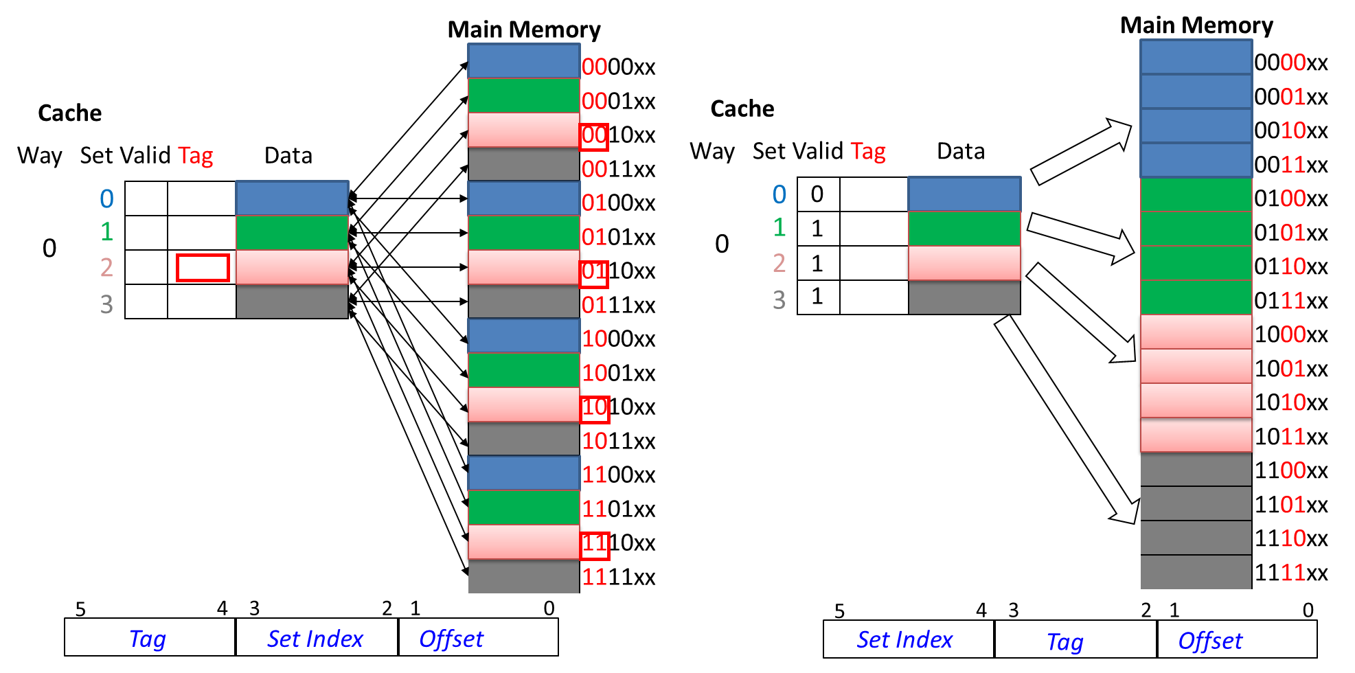
Quiz: # Cache Misses for DM Cache
Consider the following (silly) program that repeatedly accesses an array of 4-Byte ints A[4]
for (int i=0; i++, i<10000) {sum += A[0]+A[1]+A[2]+A[3];}
Suppose A[0] starts at memory address 000000, how many cache misses due to reading array A[] for a DM cache with either 1) the Tag-Set Index-Offset model; or 2) the Set Index-Tag-Offset model? (Assuming that LDR is used to load elements of A[] in every iteration, instead of keeping them in CPU registers.)
Notes:
4 cache misses:

Slide 43
Answer: # Cache Misses for DM Cache
Consider the following program that repeatedly accesses an array of words A[4]
for (int i=0; i++, i<10000) {sum += A[0]+A[1]+A[2]+A[3];}
Suppose A[0] starts at memory address 000000, how many cache misses due to reading array A[] for a DM cache with either 1) the Tag-Set Index-Offset model; or 2) the Set Index-Tag-Offset model?
For Tag-Set Index-Offset model: 4 misses
1st cache miss brings into cache a block with address 0000xx into Set 0, which contains A[0]
2nd cache miss brings into cache a block with address 0001xx into Set 1, which contains A[1]
3rd cache miss brings into cache a block with address 0010xx into Set 2, which contains A[2]
4th cache miss brings into cache a block with address 0011xx into Set 3, which contains A[3]
9996 cache hits.
For Set Index-Tag-Offset model: 10000 misses
1st cache miss brings into cache a block with address 0000xx into Set 0, which contains A[0]
2nd cache miss brings into cache a block with address 0001xx into Set 0, which contains A[1], and replaces A[0]
3rd cache miss brings into cache a block with address 0010xx into Set 0, which contains A[2], and replaces A[1]
4th cache miss brings into cache a block with address 0011xx into Set 0, which contains A[3], and replaces A[2]
5th cache miss brings into cache a block with address 0000xx into Set 0, which contains A[0], and replaces A[3]
…
Tag-Set Index-Offset model has better spatial locality!
Notes:
4 cache misses:

Slide 44
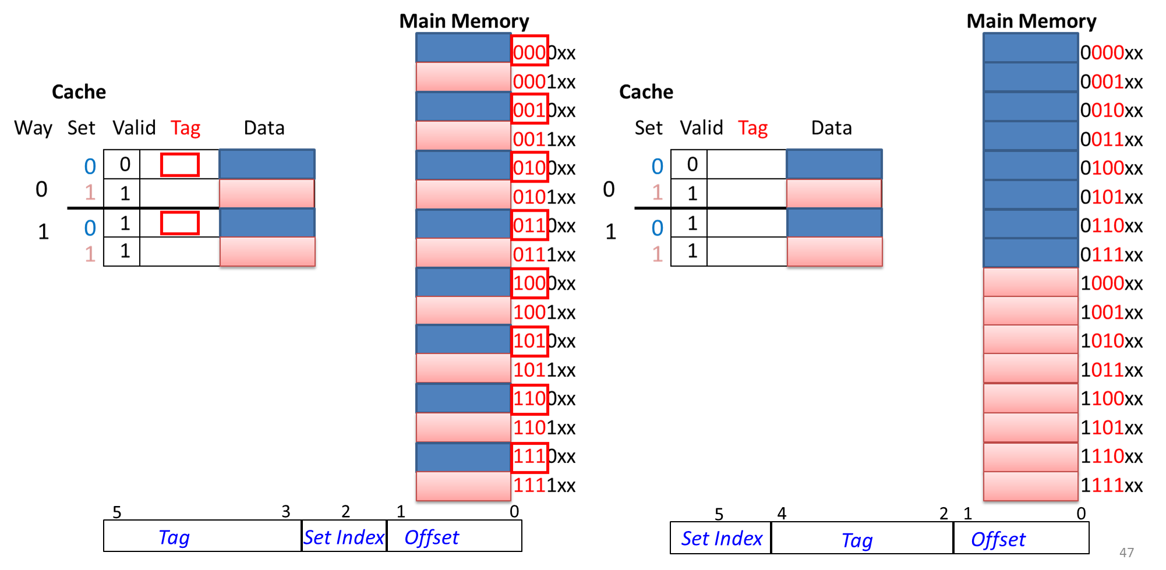
Quiz: # Cache Misses for 2-Way SA Cache
Consider the following program that repeatedly accesses an array of words A[4]
for (int i=0; i++, i<10000) {sum += A[0]+A[1]+A[2]+A[3];}
Suppose A[0] starts at memory address 000000, how many cache misses due to reading array A[] for a 2-way SA cache with either 1) the Tag-Set Index-Offset model; or 2) the Set Index-Tag-Offset model?
Notes:
4 cache misses:

Slide 45
Answer: # Cache Misses for 2-Way SA Cache
Consider the following program that repeatedly accesses an array of words A[4]
for (int i=0; i++, i<10000) {sum += A[0]+A[1]+A[2]+A[3];}
Suppose A[0] starts at memory address 000000, how many cache misses due to reading array A[] for a 2-way SA cache with either 1) the Tag-Set Index-Offset model; or 2) the Set Index-Tag-Offset model?
For Tag-Set Index-Offset model: 4 misses
1st cache miss brings into cache a block with address 0000xx into Set 0, which contains A[0]
2nd cache miss brings into cache a block with address 0001xx into Set 1, which contains A[1]
3rd cache miss brings into cache a block with address 0010xx into Set 0, which contains A[2]
4th cache miss brings into cache a block with address 0011xx into Set 1, which contains A[3]
9996 cache hits.
For Set Index-Tag-Offset model: 10000 misses for LRU (Least-Recently-Used) replacement policy
1st cache miss brings into cache a block with address 0000xx into Set 0, which contains A[0]
2nd cache miss brings into cache a block with address 0001xx into Set 0, which contains A[1]
3rd cache miss brings into cache a block with address 0010xx into Set 0, which contains A[2], and replaces A[0].
4th cache miss brings into cache a block with address 0011xx into Set 0, which contains A[3], and replaces A[1].
5th cache miss brings into cache a block with address 0000xx into Set 0, and replaces A[2].
Similar process repeats for Set 1.
(MRU (Most-Recently-Used) replacement policy can keep A[0] and A[2] in cache, leading to lower Miss rate. Details omitted)
Tag-Set Index-Offset model has better spatial locality!
Notes:
4 cache misses:

Slide 46
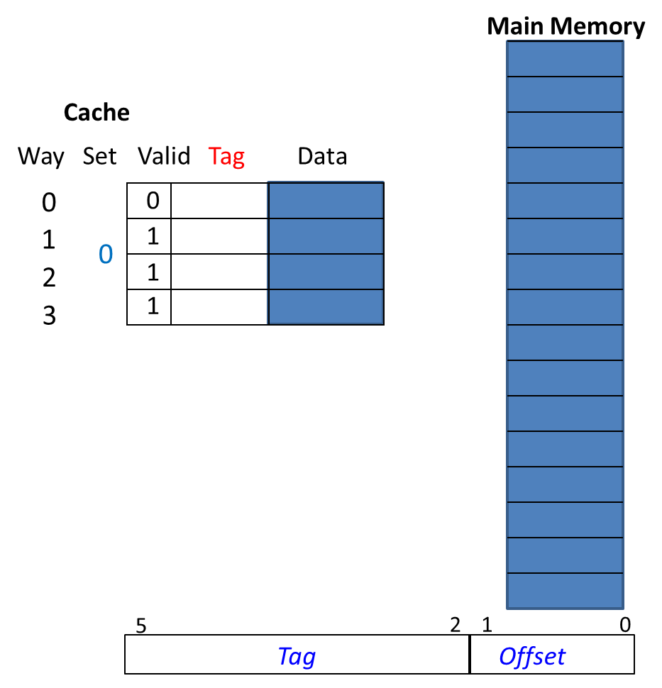
Quiz: # Cache Misses for FA Cache
Consider the following program that repeatedly accesses an array of words A[4]
for (int i=0; i++, i<10000) {sum += A[0]+A[1]+A[2]+A[3];}
Suppose A[0] starts at memory address 000000, how many cache misses due to reading array A[] for a FA cache with either 1) the Tag-Set Index-Offset model; or 2) the Set Index-Tag-Offset model?
Notes:
4 cache misses:

Slide 47
Answer: # Cache Misses for FA Cache
Consider the following program that repeatedly accesses an array of words A[4]
for (int i=0; i++, i<10000) {sum += A[0]+A[1]+A[2]+A[3];}
Suppose A[0] starts at memory address 000000, how many cache misses due to reading array A[] for a FA cache with either 1) the Tag-Set Index-Offset model; or 2) the Set Index-Tag-Offset model?
For either model: 4 misses
1st cache miss brings into cache a block with address 0000xx into Set 0, which contains A[0]
2nd cache miss brings into cache a block with address 0001xx into Set 0, which contains A[1]
3rd cache miss brings into cache a block with address 0010xx into Set 0, which contains A[2]
4th cache miss brings into cache a block with address 0011xx into Set 0, which contains A[3]
9996 cache hits.
Trick question! There is no Set Index, so the two models are the same!
Notes:
4 cache misses:

Slide 48
Key Equations
# sets = 2^{SI size}; # Bytes/block=2^{Offset size}
# blocks = # ways (associativity) * # sets
cache capacity = # blocks * # Bytes/block
Tag size does not affect cache capacity; depends on memory address length
SI size determines # sets = 2^{SI size}
Offset size determines Bytes/block = 2^{Offset size}
Tag
Set Index
Offset
5/3/2018
Notes:
Total # cache blocks = Associativity * # sets = #ways (blocks/set) × # sets × Bytes/block C = N × S × B

Slide 49
2D Visualization of Cache Organization
# ways (associativity)
#blocks = #ways * #sets
# sets

Slide 50
Cache Example
5
4
3
2
1
0
Tag
Set Index
Offset
Mem Block Within $Block
Block Within $
Byte Within Block
Assume: DM cache; 6-bit memory address: 2-bit Tag, 2-bit index, 2-bit Offset. Compute cache capacity and memory size.
2-bit Offset => Bytes/block = 4;
# sets = 2^{SI Size} = 4
# cache blocks = # ways * # sets = 1*4 = 4
cache capacity = # cache blocks * Bytes/block = 4*4 = 16B
Memory size: 2^4 (2-bit tag +2-bit SI) = 16 blocks = 64 Bytes
Recall:
# sets = 2^{SI size}; # Bytes/block=2^{Offset size}
# blocks = # ways (associativity) * # sets
cache capacity = # blocks * # Bytes/block
Notes:
16 Memory blocks = 16 words = 64 bytes => 6 bits to address all bytes (Memory and cache blocks always have the same size) 4 Cache blocks, 4 bytes (1 word) per block
4 sets *1 block per set (direct mapped cache) = 4 blocks =
# Memory blocks (16) >> # Cache blocks (4)
4 Memory blocks map to each cache block
Given a memory block, how to determine which cache set it is mapped to?
Look at Set Index: middle two bits
A cache set may contain 1 of 4 possible memory blocks, which exact memory block is mapped to it?
Look at tag: top two bits

Slide 51
Range of SA Caches
Used for tag compare
Selects the set
Selects the Byte in the block
Tag
Set Index
Offset
Increasing associativity, higher way, less sets
Decreasing associativity, lower way, more sets
Fully associative (only one set)
Tag is all bits in memory address
except Offset
Direct mapped
(only one way)
Smaller tags, only a single comparator
memory_address_size = tag_size (T) + set_index_size (SI) + block_offset_size (BO)
For a fixed-size cache, and a given block size, if we decrease the size of the index by 1 bit and increases the size of the tag by 1 bit (pushing the red bar to the right by 1 bit) :
Doubled: #ways = #blocks per cache set = associativity
Halved: #cache sets
Quiz: what if Tag has 0 bits?
Then cache has same size as memory → clearly unrealistic!
5/3/2018
Notes:
each increase by a factor of two in associativity doubles the number of blocks per set (i.e., the number of “ways”) and halves the number of sets

Slide 52
Alternative Cache Organizations
Review
A memory block is mapped to one cache set, which may contain one or more cache blocks
Direct Mapped (DM)
Each cache set has 1 cache block; # cache sets = # cache blocks
A memory block is mapped to 1 possible cache block
Fully Associative (FA)
A single cache set contains all cache blocks; # cache sets = 1
A memory block can be mapped to any cache block
N-way Set Associative (SA)
Each cache set has N cache blocks; # cache sets = # cache blocks / N
N is also called associativity
A memory block can be mapped to one of N possible cache blocks
DM and FA are special cases of SA
DM = 1-way SA (N = 1)
FA = N-way SA (N = total number of cache blocks)
5/3/2018

Slide 53
4-Block Cache Summary (Valid Bit Omitted)
DA Cache
2-way SA Cache
Set
Tag
Data
Set
Tag
Data
Set
Tag
Data
Tag
Data
0
0
Redraw
0
1
1
1
2
0
Way 0
Way 1
3
1
5
4
3
2
1
0
5
3
2
1
0
Tag
Set Index
Offset
Tag
Set Index
Offset
# cache blocks = 1 way * 4 sets = 4
# cache blocks = 2 ways * 2 sets = 4
FA Cache (4-way SA)
Way
Set
Tag
Data
Redraw
0
0101
1
1110
Tag
Data
Tag
Data
Tag
Data
Tag
Data
0
Set 0
2
1010
0011
Way 0
Way 1
Way 2
Way 3
3
5
2
1
0
Tag
Offset
# cache blocks= 4 ways * 1 set = 4
Notes:
Total size of $ in blocks is equal to number of sets x associativity. For fixed $ size, increasing associativity decreases number of sets while increasing number of elements per set. With eight blocks, an 8-way set-associative $ is same as a fully associative $.

Slide 54
8-Block Cache
Each color denotes a cache set
DM:
8 sets
1 way
Set 0
2-Way SA: 4 sets,
2 ways
Set 0
4-Way SA: 2 sets,
4 ways
Set 0
FA: 1 set
1 set,
8 ways
Set 0
Set 0
Set 1
Set 1
Set 1
Set 0
Set 0
Set 2
Set 2
Set 0
Set 0
Set 1
Set 3
Set 3
Set 1
Set 0
Set 4
Set 0
Set 0
Set 0
Set 2
Set 5
Set 1
Set 1
Set 0
Set 1
Set 6
Set 2
Set 0
Set 0
Set 3
Set 7
Set 3
Set 1
Set 0
N-1
5
4
2
1
0
N-1
4
3
2
1
0
N-1
3
2
1
0
N-1
2
1
0
Tag
S.I
O
Tag
S.I
O
Tag
S.I
O
Tag
O
# cache blocks = 1 way * 8 sets =8
# cache blocks = 2 ways * 4 sets =8
# cache blocks = 4 ways * 2 sets =8
# cache blocks = 8 ways * 1 set =8
54
Notes:
Direct Mapped: 1 way, 8 sets, 8 blocks
2 Way Set Associative: 2 ways, 4 sets, 8 blocks
4 Way Set Associative: 4 ways, 2 sets, 8 blocks
Fully Associative: 8 ways, 1 set, 8 blocks

Slide 55
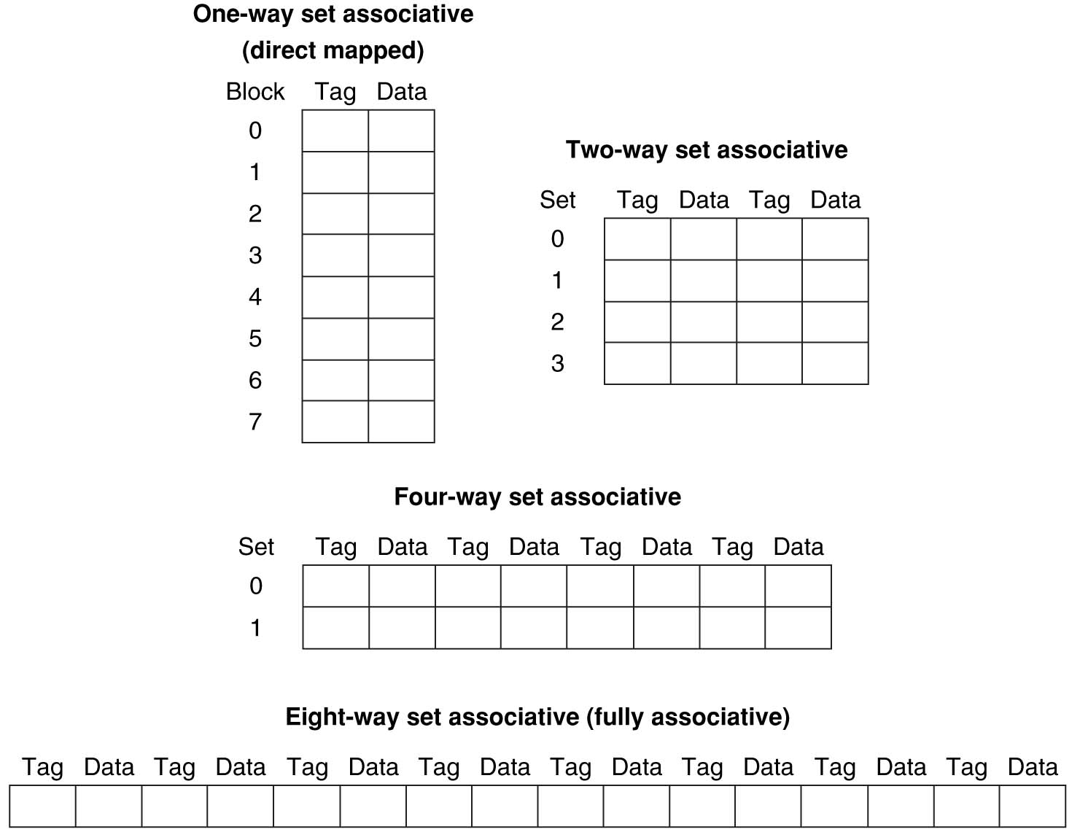
8-Block Cache Summary
More ways (associativity) → fewer cache sets → cache structure is more “short (vertically) and fat (horizontally)”
Fewer ways (associativity) → more cache sets → cache structure is more “tall (vertically) and skinny (horizontally)”
Notes:
Total size of $ in blocks is equal to number of sets x associativity. For fixed $ size, increasing associativity decreases number of sets while increasing number of elements per set. With eight blocks, an 8-way set-associative $ is same as a fully associative $.

Slide 56
DM Cache Hardware (6-bit Memory)
1. Set selection: the cache set index is used to select a set (1 block) from the cache.
2. Tag comparison: The tag of that block is compared with the higher bits of the memory address with HW comparator
3. Data output: If the tag matches, and the block’s Valid bit is 1, we have a cache hit; select and output 32-bit data of that cache block; Otherwise, we have a cache miss.
5
4
3
2
1
0
Tag
Set Index
Offset
Tag
2
2
Data
Index
Cache
Set
Valid
Tag
Data
0
A cache set contains 1 cache block with 4B of data
1
Total of 4 cache sets
2
3
Set selection
Tag comparison
Data output
Output 32-bit data if Hit
2
32
Comparator compares cache tag with higher part of memory address to see if it’s a Hit
5/3/2018
Hit?
AND gate
Notes:
Let’s use a specific example with realistic numbers: assume we have a 1 K word (4Kbyte) direct mapped cache with block size equals to 4 bytes (1 word).
In other words, each block associated with the cache tag will have 4 bytes in it (Row 1).
With Block Size equals to 4 bytes, the 2 least significant bits of the address will be used as byte select within the cache block.
Since the cache size is 1K word, the upper 32 minus 10+2 bits, or 20 bits of the address will be stored as cache tag.
The rest of the (10) address bits in the middle, that is bit 2 through 11, will be used as Cache Index to select the proper cache entry
What kind of locality are we taking advantage of?
The cache set index is used to select a set from the cache
The tags of 2 cache blocks in the set are compared in parallel with the higher bits of the memory address with HW comparator
If no tags match, we have a cache miss.
Otherwise, we have a cache hit, and we will select and output 32-bit data of the cache clock from the way where the tag match occurred, with 2x1 Mux
Temporal!

Slide 57
2-way SA Cache Hardware (6-bit Memory)
5
3
2
0
1
Tag
Set Index
Offset
Hit
Tag
3
1
Index
A cache set contains 2 blocks with 8B of data
Set
Valid
Tag
Data
Tag
Data
0
1
Total of 2 cache sets
32
32
3
3
AND gate
AND gate
Set selection
Tag comparison
Data output
2x1 Mux
OR Gate
Output 32-bit data if Hit, from the way where the Tag matched
Hit?
32
Notes:
Let’s use a specific example with realistic numbers: assume we have a 1 K word (4Kbyte) direct mapped cache with block size equals to 4 bytes (1 word).
In other words, each block associated with the cache tag will have 4 bytes in it (Row 1).
With Block Size equals to 4 bytes, the 2 least significant bits of the address will be used as byte select within the cache block.
Since the cache size is 1K word, the upper 32 minus 10+2 bits, or 20 bits of the address will be stored as cache tag.
The rest of the (10) address bits in the middle, that is bit 2 through 11, will be used as Cache Index to select the proper cache entry
What kind of locality are we taking advantage of?
Need to compare every tag in each set to the Processor address
Tag comparators are expensive
Optimization: use two “sets” of data with a total of only 2 comparators
Use one Address bit to select which set
Compare only tags from selected set
Generalize to more sets
Temporal!

Slide 58
Notes on 2-Way SA Cache
1. Set selection: the cache set index is used to select a set (2 blocks) from the cache.
2. Tag comparison: Tags of the 2 blocks in the set are compared with the higher bits of the memory address with 2 HW comparators in parallel
3. Data output: If one of the tags matches (the OR gate outputs true if any input is true), and that block’s Valid bit is 1, we have a cache hit; select and output 32-bit data of that cache block from the way where the tag matched, with 2x1 Mux. Otherwise, we have a cache miss
The cache controller hardware always returns a 32-bit word; the application software can use the Offset bits for Byte-addressing into the word.
Think of 2-way SA cache as two DM caches working in parallel
More hardware needed than DM cache: 2 comparators; 1 Mux
Notes:
Essentially, you have 4 direct-mapped cache working in parallel.

Slide 59
DM Cache Hardware (32-bit Memory)
32-bit memory address: 20-bit Tag, 10-bit set index, 2-bit Offset (each cache block is 4 Bytes).
Cache size: 1 way * 2^{^10} (10-bit set index) = 1K blocks = 1K Words (4 KB)
Memory size: 2^{^30} (20-bit tag +10-bit set index) =1G blocks = 1G Words (4 GB)
31 30 . . . 13 12 11 . . . 2 1 0
Hit
Tag
20
10
Data
Index
Set
Valid
Tag
Data
0
1
2
.
.
.
1021
1022
1023
A cache set contains 1 cache block with 4B of data
Total of 1024 cache sets
20
32
Output 32-bit data if Hit
Set selection
Tag comparison
Data output
Hit?
AND gate
5/3/2018
Notes:
Let’s use a specific example with realistic numbers: assume we have a 1 K word (4Kbyte) direct mapped cache with block size equals to 4 bytes (1 word).
In other words, each block associated with the cache tag will have 4 bytes in it (Row 1).
With Block Size equals to 4 bytes, the 2 least significant bits of the address will be used as byte select within the cache block.
Since the cache size is 1K word, the upper 32 minus 10+2 bits, or 20 bits of the address will be stored as cache tag.
The rest of the (10) address bits in the middle, that is bit 2 through 11, will be used as Cache Index to select the proper cache entry
What kind of locality are we taking advantage of?
Temporal!

Slide 60
Multi-Word Block DM Cache
32-bit memory address: 20-bit Tag, 8-bit set index, 4-bit Offset (each cache block is 16 Bytes/4 Words).
Cache size: 1 way * 2^{^8} (8-bit set index) = .25K blocks = 1K Words (4 KB)
Memory size: 2^{^28} (20-bit tag +8-bit set index) =.25G blocks = 1G Words (4 GB)
A 4x1 Mux is needed to select a 32-bit word from 4 words in the hit cache block, controlled by the 4-bit Offset
31 30 . . . 13 12 11 . . . 4 3 2 1 0
Tag
20
8
4
Byte offset
Index
Set
Valid
Tag
Data
0
1
2
.
.
.
253
254
255
A cache set contains 1 cache block with 16B of data
Total of 256 cache sets
Set selection
Tag comparison
Data output
20
4x1 Mux
Output 32-bit data if Hit, taking into account Byte offset
Hit?
AND gate
5/3/2018
32
Notes:
to take advantage for spatial locality want a cache block that is larger than word word in size. What kind of locality are we taking advantage of?

Slide 61
4-Way SA Cache Hardware (32-bit Memory)
Assume: 32-bit memory address: 22-bit Tag, 8-bit set index, 2-bit Offset (each cache block is 4 Bytes/1 Word). Cache size: 4 ways * 2^{^8} (8-bit set index) = 1K blocks = 1K Words (4 KB)
31 30 . . . 13 12 11 . . . 2 1 0
Byte offset
Tag
22
8
Index
Set
V
Tag
Data
V
Tag
Data
V
Tag
Data
V
Tag
Data
0
1
2
.
.
.
253
254
255
0
1
2
.
.
.
253
254
255
0
1
2
.
.
.
253
254
255
0
1
2
.
.
.
253
254
255
A cache set contains 4 cache blocks
Way 0
Way 1
Way 2
Way 3
Total of 256 cache sets
Set selection
Tag comparison
Data output
32
4x1 mux
Output 32-bit data if Hit, from the way where the Tag matched
5/3/2018
Hit?
32
Notes:
This is simple enough. What is its disadvantages?
2⁸ = 256 sets each with four ways (each with one block)
+1 = 36 min. (Y:16)

Slide 62
DM Cache HW Structure (Generic)
Tag
Set Index
BOffset
t
k
b
V
Tag
Data
2^{k}
sets
t
=
Set selection
Tag comparison
Data output
Mux
Hit?
Data

Slide 63
SA Cache HW Structure (Generic)
Tag
Index
Offset
b
t
k
V
Tag
Data
V
Tag
Data
t
=
=
Set selection
Tag comparison
Data output
Mux
Data
Hit?
63
Notes:
Compare latency to direct mapped case? (jse)

Slide 64
Alternative Cache Organizations: HW Costs
Need to compare every tag in each cache set to the memory address; no need to compare tags in different cache sets
# HW comparators == # cache blocks in each cache set = # ways = associativity
Direct Mapped: a memory block is mapped to one address in cache
# cache sets = # cache blocks; each cache set has 1 cache block
# HW comparators = 1
Fully Associative: a memory block can be mapped to any address in cache
# cache sets = 1; it contains all cache blocks
# HW comparators = # cache blocks, plus a HW mux
N-way Set Associative: a memory block can be mapped to one of N possible addresses in cache
# cache sets = # cache blocks / N; each cache set has N cache blocks
Fully Associative: N = total number of cache blocks
Direct Mapped: N = 1
N HW comparators, plus a HW mux
5/3/2018

Slide 65
N-way SA Cache: Performance Costs
Performance costs
N-way SA cache: N HW comparators make Hit/Miss decision; Mux selects a way out of N ways (the hit cache block); output data
DM cache: single HW comparator makes Hit/Miss decision; output data
Speculative execution optimization: output cache block data before Tag comparison makes Hit/Miss decision; execute optimistically assuming it is a hit; recover later if it turns out to be a miss; works well if hit rate is high
Instead of 1) Set selection; 2) Tag comparison; 3) Data output,
we have 1) Set selection; 2) (Data output & Tag comparison) in parallel
This optimization for DM cache does not work for N-way SA cache. Why?
For N-way SA cache, data is available only after Hit/Miss decision; if hit, the Mux selects a block from one of N ways
N possible hit cache blocks before Mux finishes selection
But SA cache reduces miss rate by having more flexible cache block placement
When miss occurs, which block is selected for replacement?
Least Recently Used (LRU): one that has been unused the longest (principle of temporal locality)
In summary: higher associativity → higher hit time & lower miss rate
5/3/2018
Notes:
First of all, a N-way set associative cache will need N comparators instead of just one comparator (use the right side of the diagram for direct mapped cache).
A N-way set associative cache will also be slower than a direct mapped cache because of this extra multiplexer delay.
Finally, for a N-way set associative cache, the data will be available AFTER the hit/miss signal becomes valid because the hit/mis is needed to control the data MUX.
For a direct mapped cache, that is everything before the MUX on the right or left side, the cache block will be available BEFORE the hit/miss signal (AND gate output) because the data does not have to go through the comparator.
This can be an important consideration because the processor can now go ahead and use the data without knowing if it is a Hit or Miss. Just assume it is a hit.
Since cache hit rate is in the upper 90% range, you will be ahead of the game 90% of the time and for those 10% of the time that you are wrong, just make sure you can recover.
You cannot play this speculation game with a N-way set-associative cache because as I said earlier, the data will not be available to you until the hit/miss signal is valid.
Data available after set selection (and Hit/Miss decision). DM $: block is available before the Hit/Miss decision
In Set-Associative, not possible to just assume a hit and continue and recover later if it was a miss
+2 = 38 min. (Y:18)
(delay and area)
Mux delay (set selection) before data is available

Slide 66
Outline
Memory Hierarchy and Latency
Cache Principles
Basic Cache Organization
Different Kinds of Caches
Write Back vs. Write Through
Summary
5/3/2018
Fall 2017 – Lecture #14

Slide 67
Handling Stores with Write-Through
Store instructions write to memory, changing values
Need to make sure cache and memory have same values on writes: two policies
1) Write-Through Policy: write cache and write through the cache to memory
Every write updates both cache and memory
Optimization: insert a small write buffer between cache and memory to allow processor to continue once data in Buffer; memory is updated from write buffer in parallel to processor execution
5/3/2018

Slide 68
Handling Stores with Write-Back
2) Write-Back Policy: write only to cache and then write cache block back to memory when the block is evicted from cache
Multiple writes collected in cache, only single write to memory per block
Include bit to see if wrote to block or not, and then only update memory if bit is set
Called “Dirty” bit (writing makes it “dirty”)
5/3/2018

Slide 69
Write-Back Cache
Store/cache hit, write data in cache only and set dirty bit
Memory has stale value
Store/cache miss, read data from memory, then update and set dirty bit
“Write-allocate” policy
Load/cache hit, use value from cache
On any miss, write back evicted block, only if it is dirty. Update cache with new block and clear dirty bit
5/3/2018
Notes:
TODO: add examples?

Slide 70
Write-Through vs. Write-Back
Write-Through:
Simpler control logic
More predictable timing simplifies processor control logic
Memory always has copy of all data in cache
Write-Back
More complex control logic
More variable timing (0,1,2 memory accesses per cache access)
Sometimes cache has only copy of data that is not in memory
Reduces write traffic → write-back is the dominant approach in modern processors
5/3/2018

Slide 71
Outline
Memory Hierarchy and Latency
Cache Principles
Basic Cache Organization
Different Kinds of Caches
Write Back vs. Write Through
Summary
5/3/2018
Fall 2017 – Lecture #14

Slide 72
Summary
Cache – copy of data in lower level of memory hierarchy
Principle of locality:
Program likely to access a relatively small range of memory addresses at any instant of time.
Temporal locality vs. spatial locality
Cache organizations:
Direct Mapped: 1 block per set
N-way Set Associative: N blocks per set
Fully Associative: all blocks in 1 set
Increasing associativity helps to reduce miss rate
N-way: N possible places in cache to hold a given memory block
5/3/2018
Notes:
Direct Mapped to find block in cache using Tag field and Valid bit for Hit Memory block maps into more than 1 cache block

